Slide 1
Debugging Intuition
How to calculate the probability of at least k successes in n trials?
X is number of successes in n trials each with probability p
First clue that something is wrong. Think about p = 1
Don’t care about the rest
Not mutually exclusive…
Probability that each is success
# ways to choose slots for success
Correct:

Slide 2
Variance
Lagunita
CS 109
Lecture 7
April 11th, 2016

Slide 3
Is Peer Grading Accurate Enough?
Peer Grading on Coursera HCI.
31,067 peer grades for 3,607 students.
Tuned Models of Peer Assessment. C Piech, J Huang, A Ng, D Koller

Slide 4
Today’s Topics
Last time:
Random Variables
Expectation + PDF
Today:
Variance
Bernoulli + Binominal RVs
Next time:
All the other discrete RVs

Slide 5
St Petersburg
Game set-up
We have a fair coin (come up “heads” with p = 0.5)
Let n = number of coin flips (“heads”) before first “tails”
You win $2^{n}
How much would you pay to play?
Solution
Let X = your winnings
E[X] =
I’ll let you play for $1 thousand... but just once! Takers?

Slide 6
St Petersburg + Reality
What if Chris has only $65,536?
Same game
If you win over $65,536 I leave the country.
Solution
Let X = your winnings
E[X]

Slide 7
Utility
Utility is value of some choice
2 options, each with n consequences: c₁, c₂,..., c_{n}
One of c_{i} will occur with probability p_{i}
Each consequence has some value (utility): U(c_{i})
Which choice do you make?
Example: Buy a $1 lottery ticket (for $1M prize)?
Probability of winning is 1/10⁷
Buy: c₁ = win, c₂ = lose, U(c₁) = 10⁶ – 1, U(c₂) = -1
Don’t Buy: c₁ = lose, U(c₁) = 0
E(buy) = 1/10⁷ (10⁶ – 1) + (1 – 1/10⁷) (-1) ≈ -0.9
E(don’t buy) = 1 (0) = 0
“You can’t lose if you don’t play!”

Slide 8
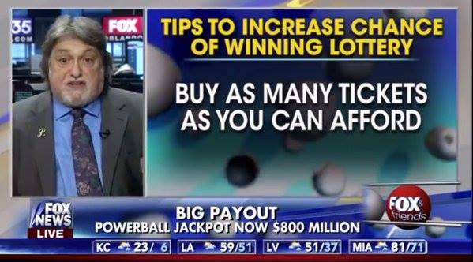
And Then There’s This
Lottery: A tax on people who are bad at math.
– Ambrose Bierce

Slide 9
Recall, Geometric Series

Slide 10
Breaking Vegas
Consider even money bet (e.g., bet “Red” in roulette)
p = 18/38 you win $Y, otherwise (1 – p) you lose $Y
Consider this algorithm for one series of bets:
Y = $1
Bet Y
If Win then stop
If Loss then Y = 2 * Y, goto 2
Let Z = winnings upon stopping
E[Z]
Expected winnings ≥ 0. Use algorithm infinitely often!

Slide 11
Vegas Breaks You
Why doesn’t everyone do this?
Real games have maximum bet amounts
You have finite money
Not able to keep doubling bet beyond certain point
Casinos can kick you out
But, if you had:
No betting limits, and
Infinite money, and
Could play as often as you want...
Then, go for it!
And tell me which planet you are living on

Slide 12


Four Prototypical Trajectories
Is E[X] enough?

Slide 13
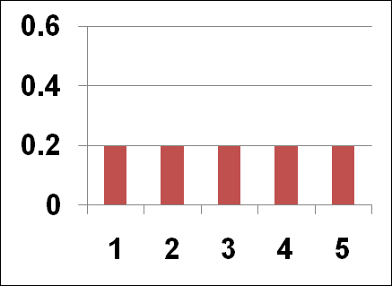
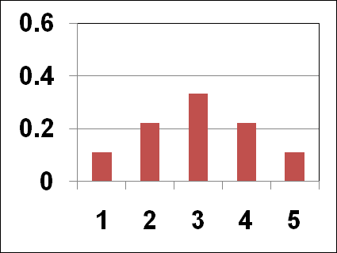
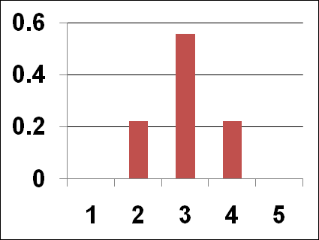
Variance
Consider the following 3 distributions (PMFs)
All have the same expected value, E[X] = 3
But “spread” in distributions is different
Variance = a formal quantification of “spread”

Slide 14
Variance
If X is a random variable with mean μ then the variance of X, denoted Var(X), is:
Var(X) = E [(X – μ)²]
Note: Var(X) ≥ 0
Also known as the 2nd Central Moment, or square of the Standard Deviation

Slide 15
Computing Variance
Ladies and gentlemen, please welcome the 2nd moment!

Slide 16
Variance of a 6 sided dice
Let X = value on roll of 6 sided die
Recall that E[X] = 7/2
Compute E[X²]

Slide 17
Properties of Variance
Var(aX + b) = a² Var(X)
Proof:
Var(aX + b) = E[(aX + b)²] – (E[aX + b])²
= E[a²X² + 2abX + b²] – (aE[X] + b)²
= a²E[X²] + 2abE[X] + b² – (a²(E[X])² + 2abE[X] + b²)
= a²E[X²] – a²(E[X])² = a²(E[X²] – (E[X])²)
= a² Var(X)
Standard Deviation of X, denoted SD(X), is:
Var(X) is in units of X²
SD(X) is in same units as X

Slide 18
Intuition
Peer Grading on Coursera HCI.
31,067 peer grades for 3,607 students.

Slide 19
Peer Grades in Coursera HCI
Let X be a random variable that represents a peer grade
True grade = 58
E[X] = 57.5
If we base a final score off 4 peer-grades, 19% of students would get a score that was off by more than 10 percentage points
0
20
40
60
80
100

Slide 20
Peer Grades in Coursera HCI
Let X be a random variable that represents a peer grade
Var(X) = E [(X – μ)²]
True grade = 58
E[X] = 57.5
0
20
40
60
80
100

Slide 21
Peer Grades in Coursera HCI
Let X be a random variable that represents a peer grade
Var(X) = E [(X – μ)²]
True grade = 58
E[X] = 57.5
X
(X – μ)²
25 points
1056 points²
0
20
40
60
80
100

Slide 22
Peer Grades in Coursera HCI
Let X be a random variable that represents a peer grade
Var(X) = E [(X – μ)²]
True grade = 58
E[X] = 57.5
X
(X – μ)²
25 points
1056 points²
80 points
506 points²
0
20
40
60
80
100

Slide 23
Peer Grades in Coursera HCI
Let X be a random variable that represents a peer grade
Var(X) = E [(X – μ)²]
True grade = 58
E[X] = 57.5
X
(X – μ)²
25 points
1056 points²
80 points
506 points²
50 points
56 points²
0
20
40
60
80
100

Slide 24
Peer Grades in Coursera HCI
Let X be a random variable that represents a peer grade
Var(X) = E [(X – μ)²]
True grade = 58
E[X] = 57.5
X
(X – μ)²
25 points
1056 points²
80 points
506 points²
50 points
56 points²
…
E [(X – μ)²] = 52 points²
0
20
40
60
80
100

Slide 25
Peer Grades in Coursera HCI
Let X be a random variable that represents a peer grade
Var(X) = E [(X – μ)²]
True grade = 58
E[X] = 57.5
X
(X – μ)²
25 points
1056 points²
80 points
506 points²
50 points
56 points²
…
E [(X – μ)²] = 52 points²
SD(X) = 7.2 points
0
20
40
60
80
100

Slide 26
Second Moment
Let X be a random variable that represents a peer grade
E [X²]
True grade = 58
E[X] = 57.5
Recall that Variance is the second central moment. What is the second moment?
0
20
40
60
80
100

Slide 27
Second Moment
Let X be a random variable that represents a peer grade
E [X²]
True grade = 58
E[X] = 57.5
Recall that Variance is the second central moment. What is the second moment?
0
20
40
60
80
100

Slide 28
Second Moment
Let X be a random variable that represents a peer grade
E [X²]
True grade = 58
E[X] = 57.5
Yea second moment really isn’t that useful a statistic in this case…
0
20
40
60
80
100

Slide 29
Four Prototypical Trajectories
Lots of fun with Random Variables

Slide 30
Four Prototypical Trajectories
Moaaahhhh Random Variables

Slide 31
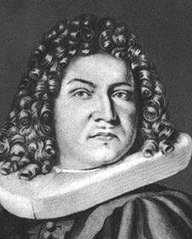

Jacob Bernoulli
Jacob Bernoulli (1654-1705), also known as “James”, was a Swiss mathematician
One of many mathematicians in Bernoulli family
The Bernoulli Random Variable is named for him
He is my academic great¹²-grandfather
Same eyes as Ice Cube

Slide 32
Bernoulli Random Variable
Experiment results in “Success” or “Failure”
X is random indicator variable (1 = success, 0 = failure)
P(X = 1) = p(1) = p P(X = 0) = p(0) = 1 – p
X is a Bernoulli Random Variable: X ~ Ber(p)
E[X] = p
Var(X) = p(1 – p)
Examples
coin flip
random binary digit
whether a disk drive crashed
whether someone likes a netflix movie
Feel the Bern!

Slide 33
Binomial Random Variable
Consider n independent trials of Ber(p) rand. var.
X is number of successes in n trials
X is a Binomial Random Variable: X ~ Bin(n, p)
By Binomial Theorem, we know that
Examples
# of heads in n coin flips
# of 1’s in randomly generated length n bit string
# of disk drives crashed in 1000 computer cluster
Assuming disks crash independently

Slide 34


Bernoulli vs Binomial
Bernoulli is a type of RV
Binomial is the sum of n
Bernoullis
+
+
+
=

Slide 35
Three Coin Flips
Three fair (“heads” with p = 0.5) coins are flipped
X is number of heads
X ~ Bin(3, 0.5)

Slide 36
Error Correcting Codes
Error correcting codes
Have original 4 bit string to send over network
Add 3 “parity” bits, and send 7 bits total
Each bit independently corrupted (flipped) in transition with probability 0.1

Slide 37
Error Correcting Codes
Key for 7 bits
Send: 1110?
Receive: 1110000?
Receive: 1010100?
Flip set: O_{i} E_{j}^{C}
for all odd sets i and even sets j

Slide 38
Error Correcting Codes
Error correcting codes
Have original 4 bit string to send over network
Add 3 “parity” bits, and send 7 bits total
Each bit independently corrupted (flipped) in transition with probability 0.1
X = number of bits corrupted: X ~ Bin(7, 0.1)
But, parity bits allow us to correct at most 1 bit error
P(a correctable message is received)?
P(X = 0) + P(X = 1)

Slide 39
Error Correcting Codes
Using error correcting codes: X ~ Bin(7, 0.1)
P(X = 0) + P(X = 1) = 0.8503
What if we didn’t use error correcting codes?
X ~ Bin(4, 0.1)
P(correct message received) = P(X = 0)
Using error correction improves reliability ~30%!

Slide 40
Genetic Inheritance
Person has 2 genes for trait (eye color)
Child receives 1 gene (equally likely) from each parent
Child has brown eyes if either (or both) genes brown
Child only has blue eyes if both genes blue
Brown is “dominant” (d) , Blue is “recessive” (r)
Parents each have 1 brown and 1 blue gene
4 children, what is P(3 children with brown eyes)?
Child has blue eyes: p = (½) (½) = ¼ (2 blue genes)
P(child has brown eyes) = 1 – (¼) = 0.75
X = # of children with brown eyes. X ~ Bin(4, 0.75)

Slide 41
Properties of Bin(n, p)
Consider: X ~ Bin(n, p)
E[X] = np
Var(X) = np(1 – p)
So, to compute E[X²], we have:
Var(X) = E[X²] – (E[X])²
E[X²] = Var(X) + (E[X])²
= np(1 – p) + (np)²
= n²p² – np² + np
Note: Ber(p) = Bin(1, p)

Slide 42
Galton Board

Slide 43
Galton Board
When a marble hits a pin, it has equal chance of going left or right.

Slide 44
Galton Board
When a marble hits a pin, it has equal chance of going left or right. Each pin represents an independent event.

Slide 45
Galton Board
The bucket index that a marble lands in is equal to the number of times the marble went right
0
1
2
3
4
5

Slide 46
Galton Board
We can define an indicator random variable (R) which represents whether a particular marble goes right as a Bernoulli R ~ Ber(0.5)
0
1
2
3
4
5

Slide 47
Galton Board
We can define an indicator random variable (B) which represents what bucket a marble lands in.
0
1
2
3
4
5

Slide 48
Galton Board
We can define an indicator random variable (B) which represents what bucket a marble lands in. B ~ Bin(levels, 0.5)
0
1
2
3
4
5

Slide 49
Galton Board
We can define an indicator random variable (B) which represents what bucket a marble lands in. B ~ Bin(5, 0.5)
0
1
2
3
4
5

Slide 50
Galton Board
We can define an indicator random variable (B) which represents what bucket a marble lands in. B ~ Bin(5, 0.5)
Calculate the probability of a marble landing in a bucket.
0
1
2
3
4
5

Slide 51
Galton Board
We can define an indicator random variable (B) which represents what bucket a marble lands in. B ~ Bin(5, 0.5)
Calculate the probability of a marble landing in a bucket.
0
1
2
3
4
5

Slide 52
Galton Board
We can define an indicator random variable (B) which represents what bucket a marble lands in. B ~ Bin(5, 0.5)
Calculate the probability of a marble landing in a bucket.
0
1
2
3
4
5

Slide 53
Galton Board
We can define an indicator random variable (B) which represents what bucket a marble lands in. B ~ Bin(5, 0.5)
Calculate the probability of a marble landing in a bucket.
0
1
2
3
4
5

Slide 54
Galton Board
We can define an indicator random variable (B) which represents what bucket a marble lands in. B ~ Bin(5, 0.5)
Calculate the probability of a marble landing in a bucket.
0
1
2
3
4
5

Slide 55
Galton Board
We can define an indicator random variable (B) which represents what bucket a marble lands in. B ~ Bin(5, 0.5)
Calculate the probability of a marble landing in a bucket.
PDF
0
1
2
3
4
5

Slide 56


Slide 57
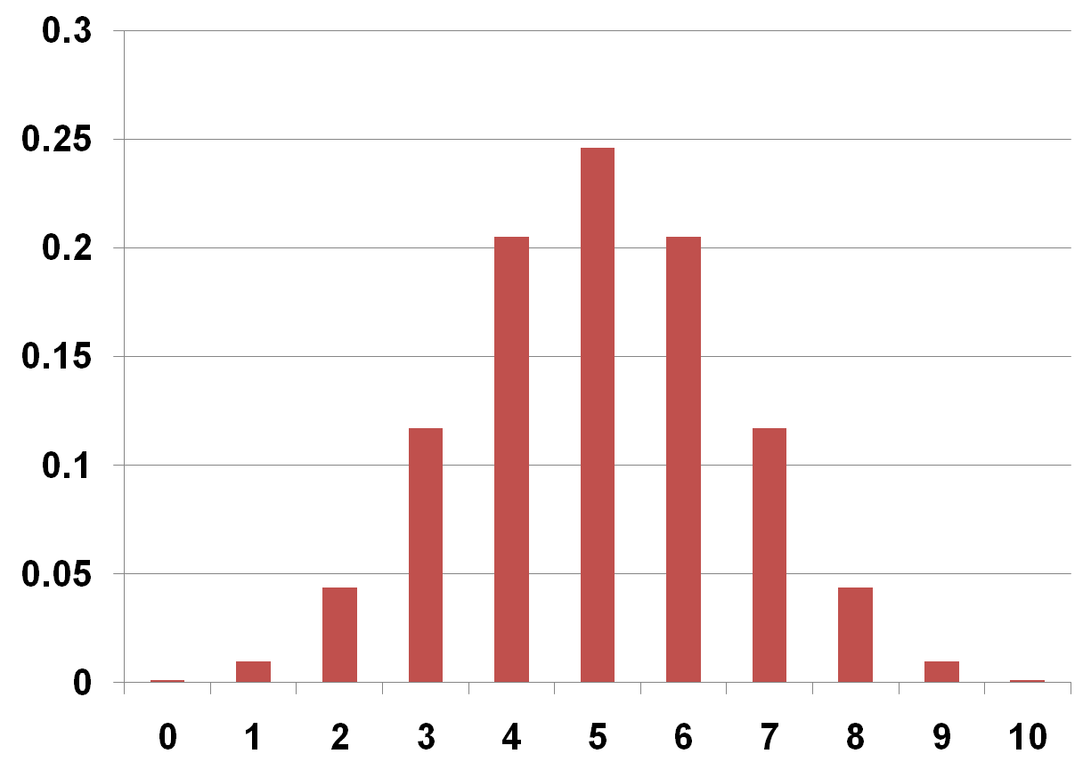
PMF for X ~ Bin(10, 0.5)
P(X=k)
k

Slide 58
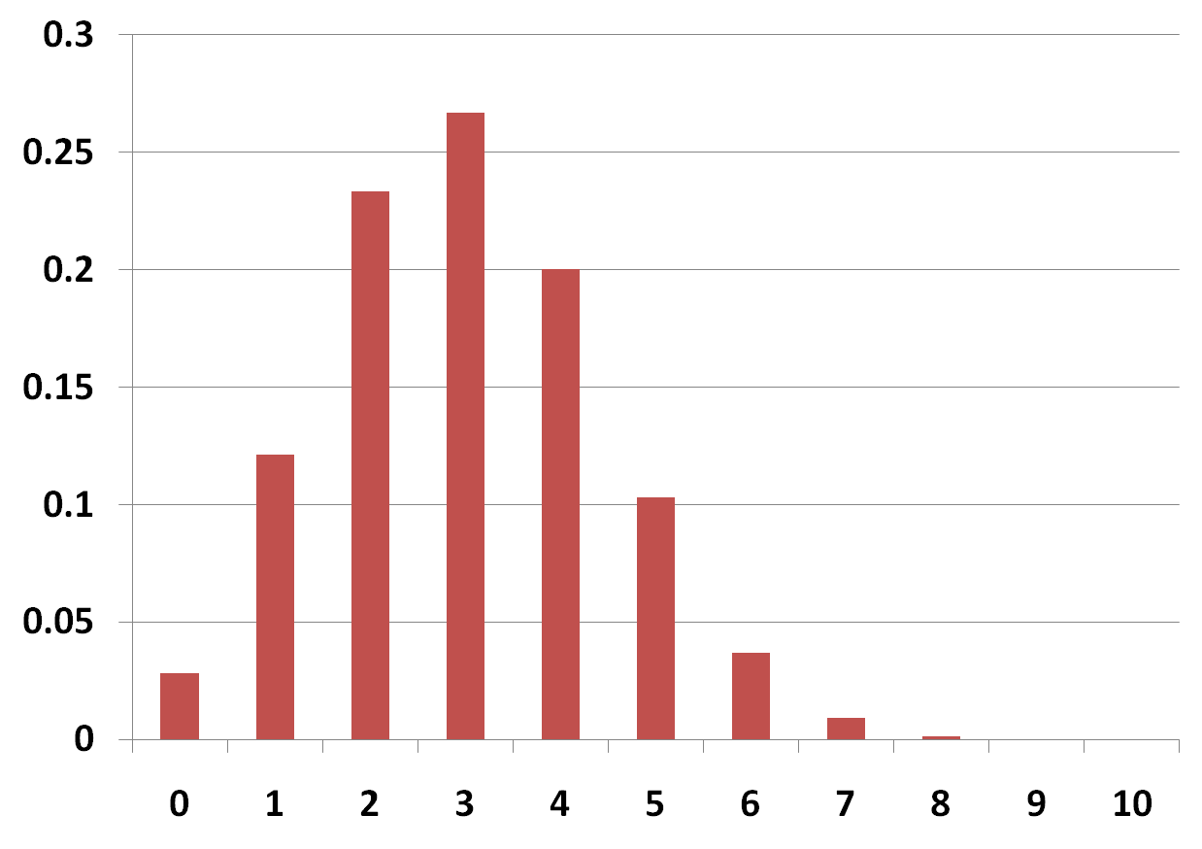
PMF for X ~ Bin(10, 0.3)
P(X=k)
k

Slide 59
Power of Your Vote
Is it better to vote in small or large state?
Small: more likely your vote changes outcome
Large: larger outcome (electoral votes) if state swings
a (= 2n) voters equally likely to vote for either candidate
You are deciding (a + 1)^{st} vote
Use Stirling’s Approximation:
Power = P(tie) * Elec. Votes =
Larger state = more power

Slide 60
Is Peer Grading Accurate Enough?
Looking ahead
Peer Grading on Coursera HCI.
31,067 peer grades for 3,607 students.
Tuned Models of Peer Assessment. C Piech, J Huang, A Ng, D Koller

Slide 61
Is Peer Grading Accurate Enough?
Looking ahead
1. Defined random variables for:
True grade (s_{i}) for assignment i
Observed (z_{i}^{j}) score for assign i
Bias (b_{j}) for each grader j
Variance (r_{j}) for each grader j
2. Designed a probabilistic model that
defined the distributions for all random variables
Problem param
Tuned Models of Peer Assessment. C Piech, J Huang, A Ng, D Koller

Slide 62
Is Peer Grading Accurate Enough?
Looking ahead
1. Defined random variables for:
True grade (s_{i}) for assignment i
Observed (z_{i}^{j}) score for assign i
Bias (b_{j}) for each grader j
Variance (r_{j}) for each grader j
2. Designed a probabilistic model that
defined the distributions for all random variables
3. Found the variable assignments that maximized the probability of our observed data
Inference or Machine Learning
Tuned Models of Peer Assessment. C Piech, J Huang, A Ng, D Koller

Slide 63
Yes, With Probabilistic Modelling
Before:
After:
99% within 10pp
Tuned Models of Peer Assessment. C Piech, J Huang, A Ng, D Koller

Slide 64
Four Prototypical Trajectories
Voilà, c'est tout

